Slide 1
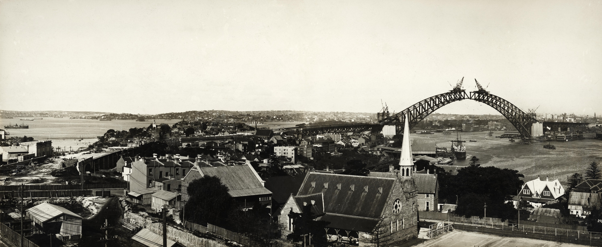

COLLECTION SERVICES
Agency Services
Collections Logistics & Valuation
Conservation
Digitisation
Manager, Sally Irvine-Smith

Slide 2
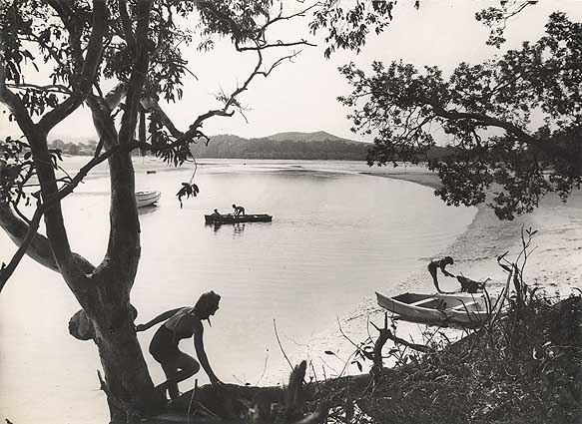
AGENCY SERVICES
A/Senior Adviser Kate Musgrave
536 separate consignments from 27 separate agencies
1228.64 meters added
4320 loose maps/plans
553,975 Aperture cards of plans relating to public works

Slide 3
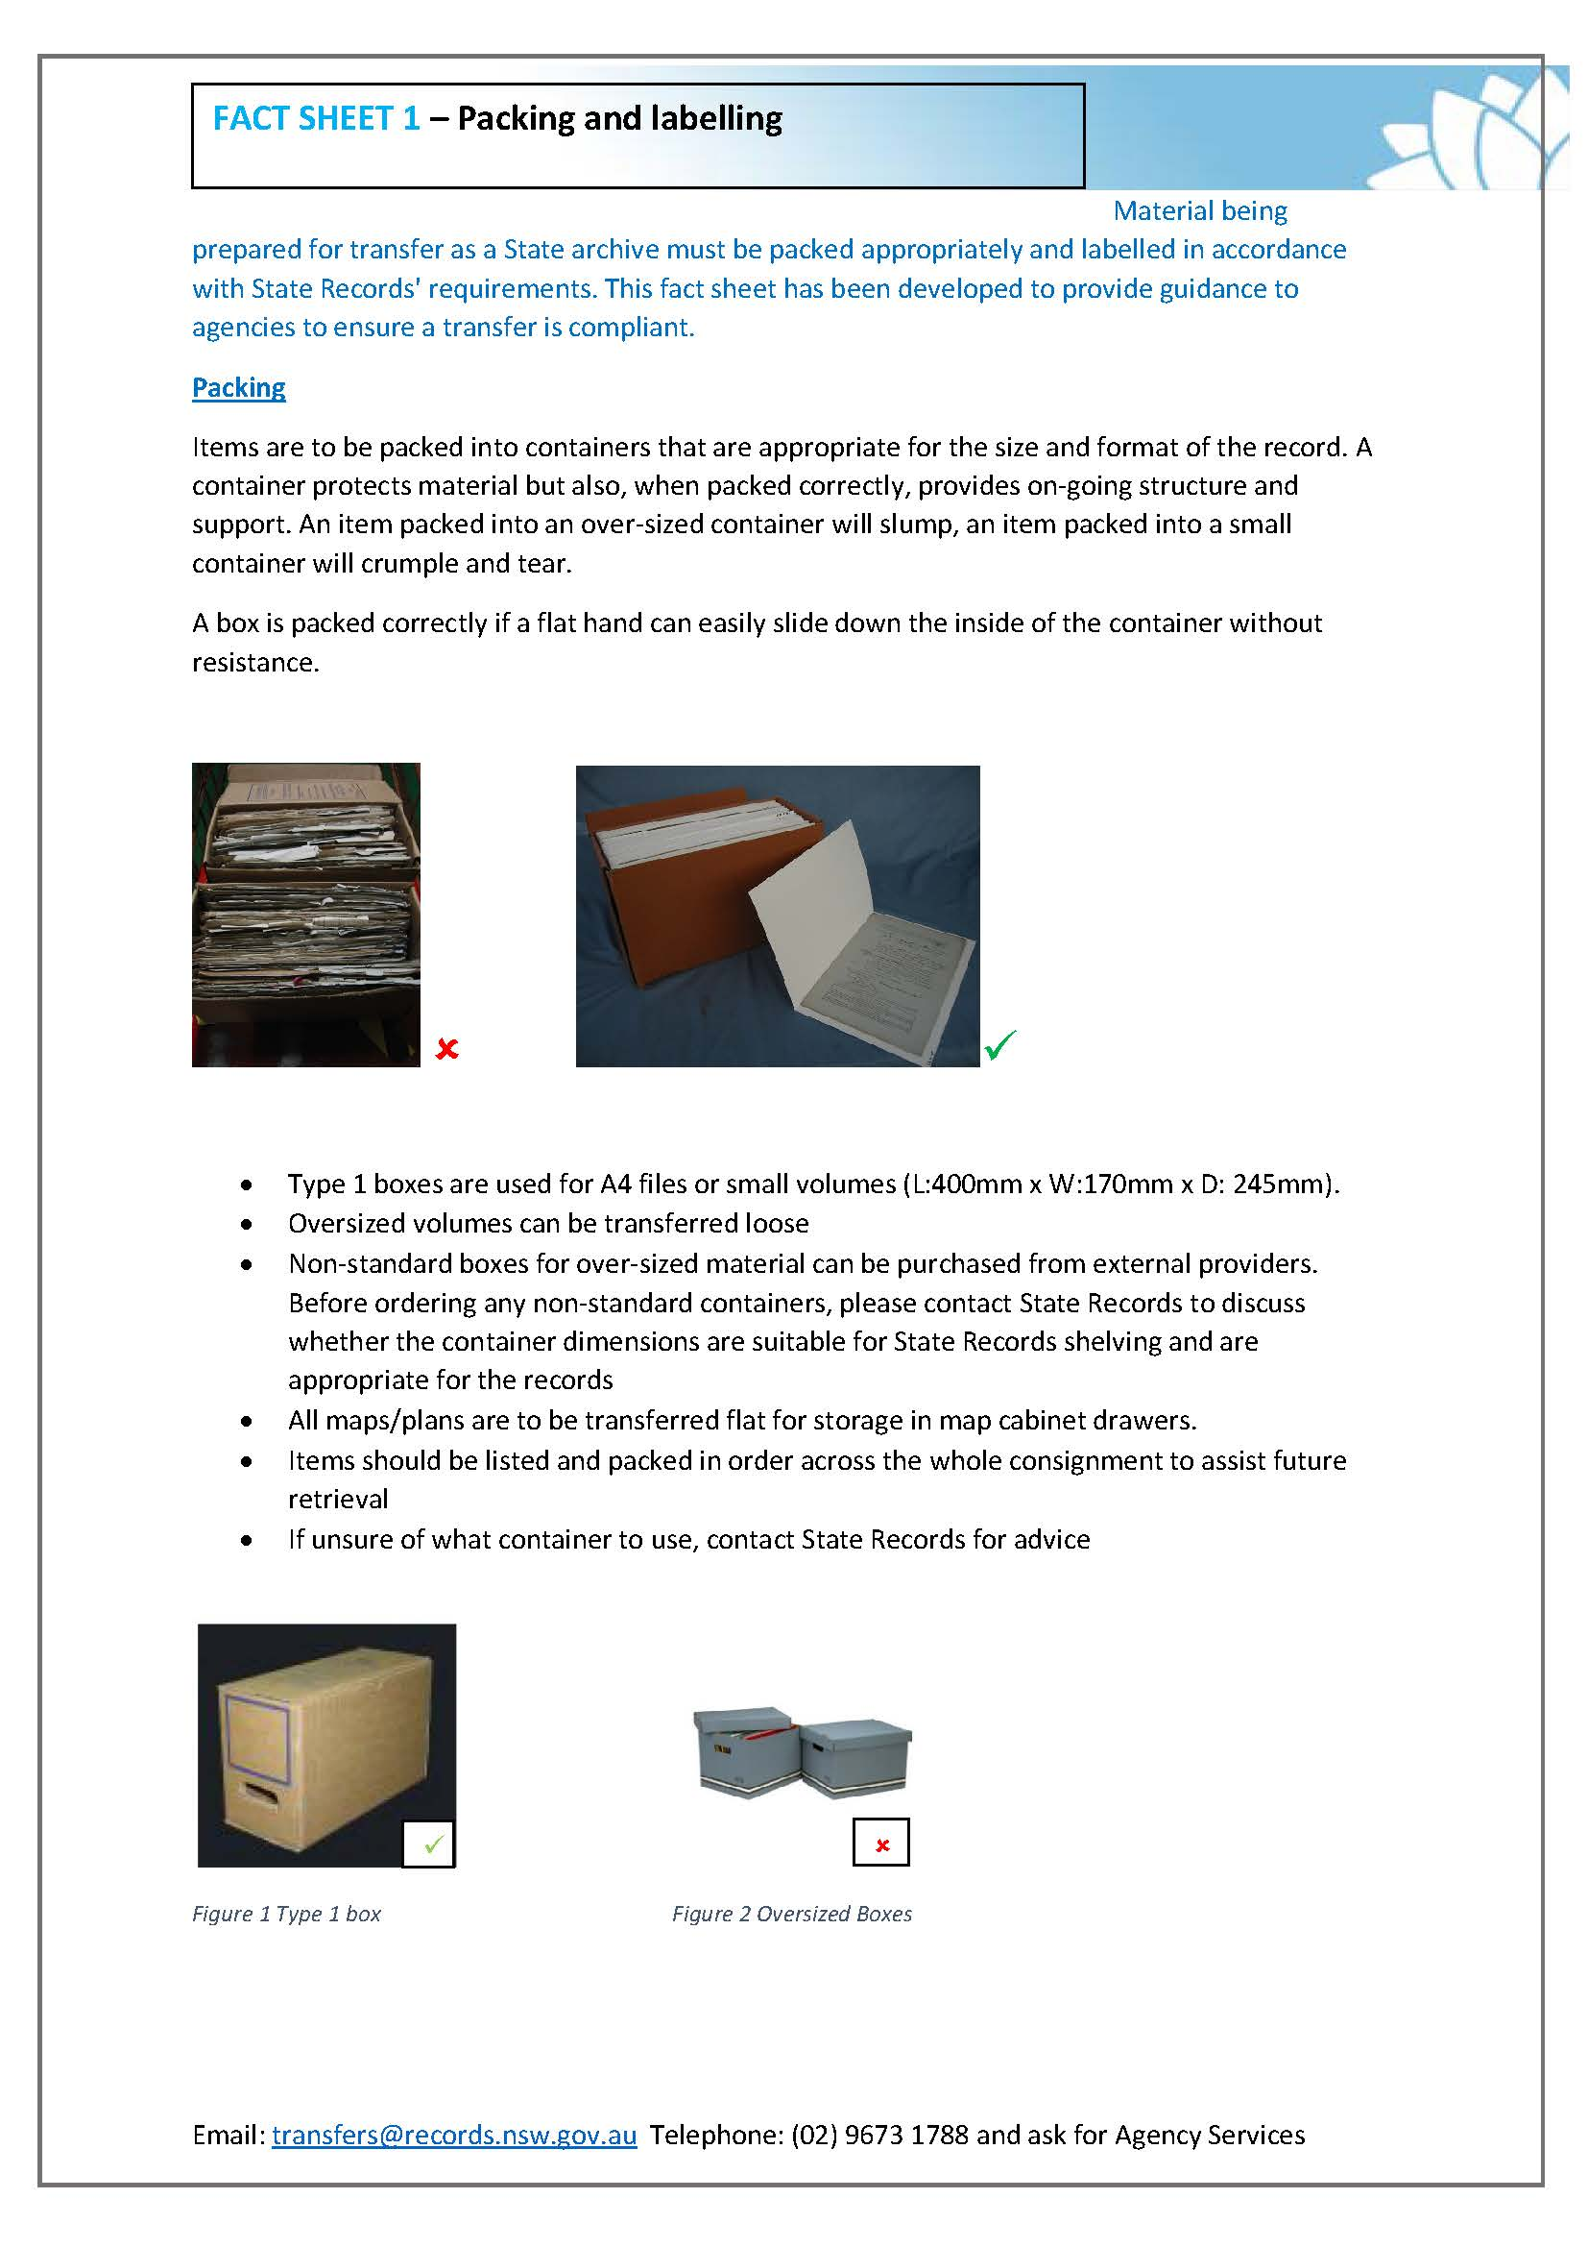
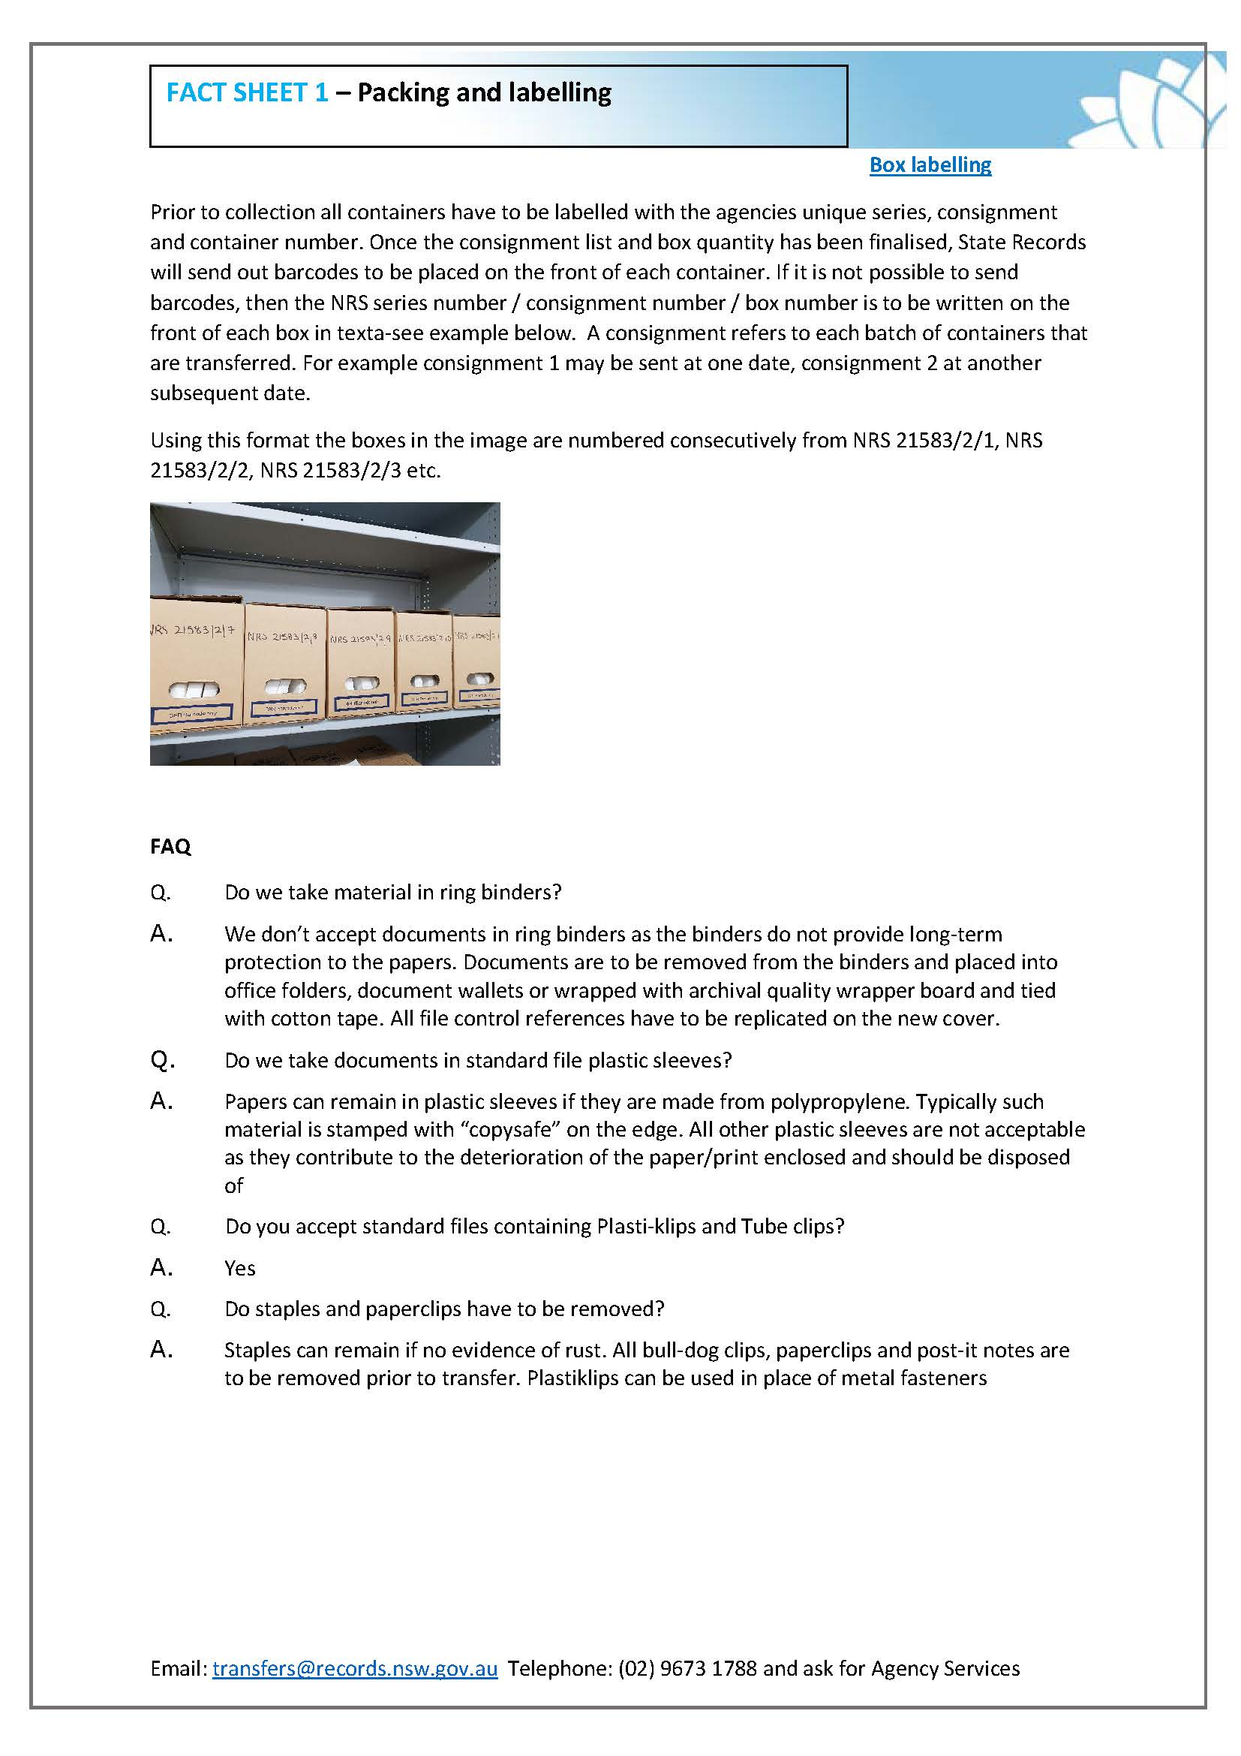
AGENCY SERVICES
Making it easier to transfer archival records

Slide 4
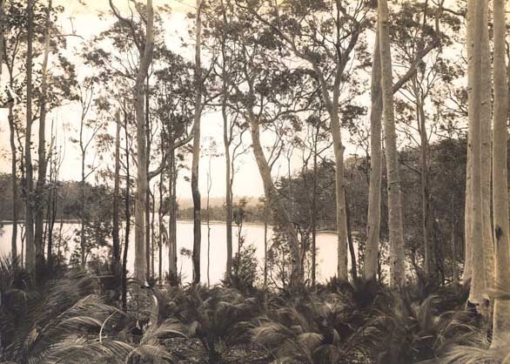
COLLECTION LOGISTICS & VALUATION
A/Senior Adviser Robert Dooley
Total valuation items – 5,964,358
Number of boxes – 237,585
Number of aperture cards – 574,994
Number of Map/Plan – 2,109,003
Number of volumes – 253,880
School record volumes – 9141
Total value at July 2019 - $995,998,917.71

Slide 5
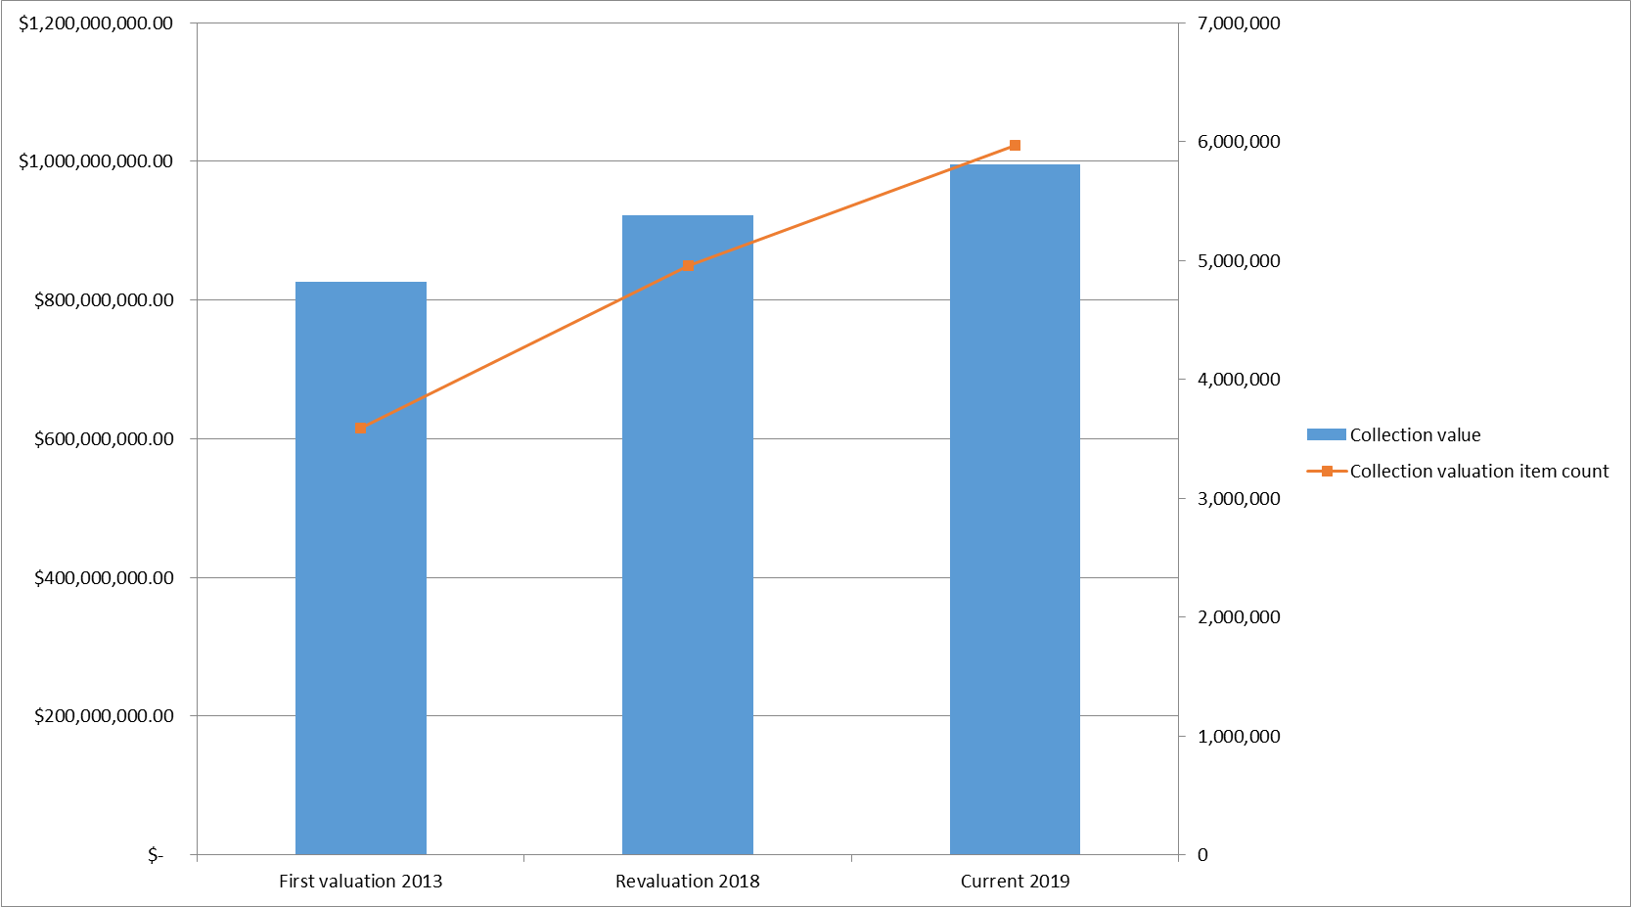
COLLECTION LOGISTICS & VALUATION
Managing a $1B asset comprising the State’s documentary heritage

Slide 6
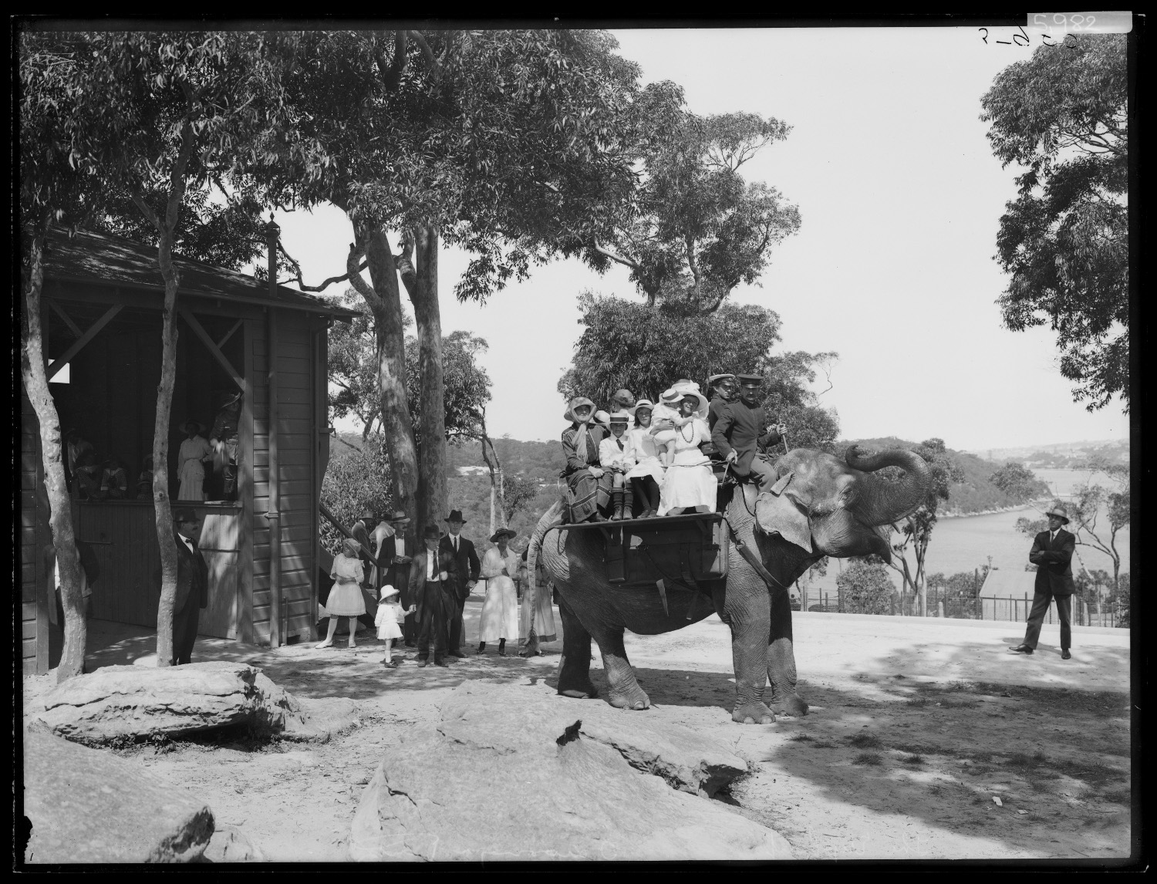
CONSERVATION
Senior Conservator Elizabeth Hadlow
5 person conservation team with a mix of paper, photographic, book and preventive skills. They repair archives for readers, digitisation, exhibitions and agency retrieval, and also carry out pest and environmental monitoring.

Slide 7
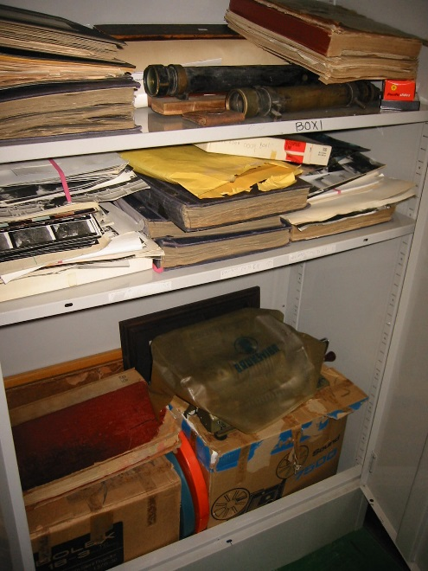
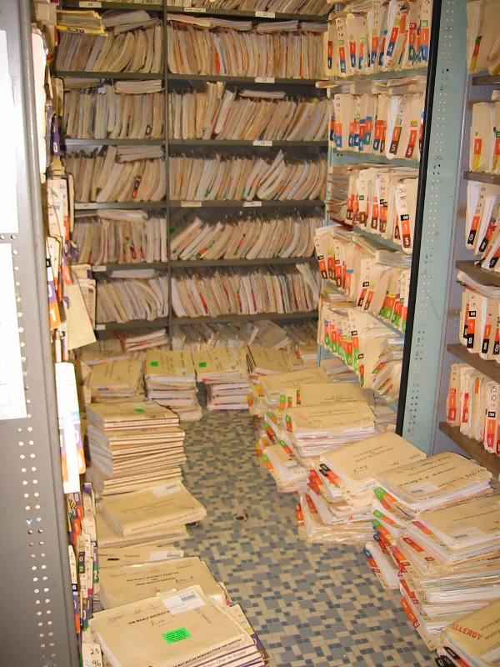
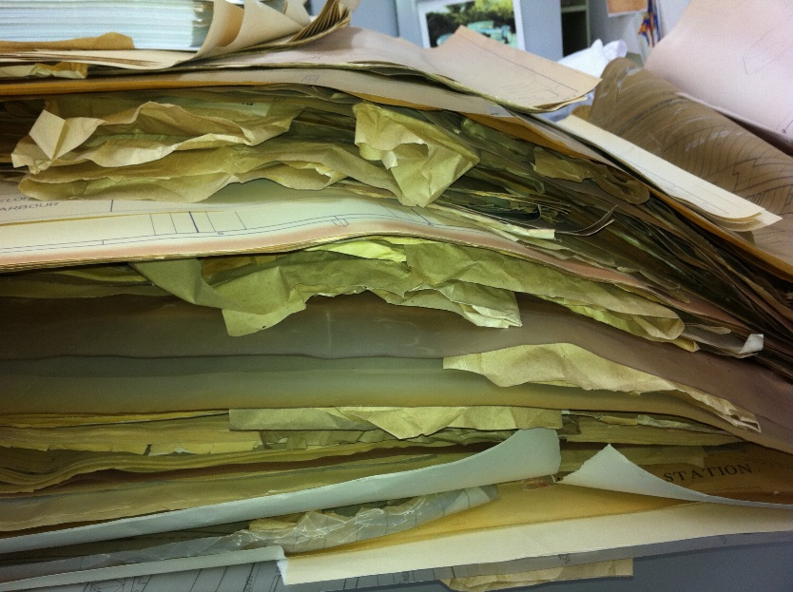
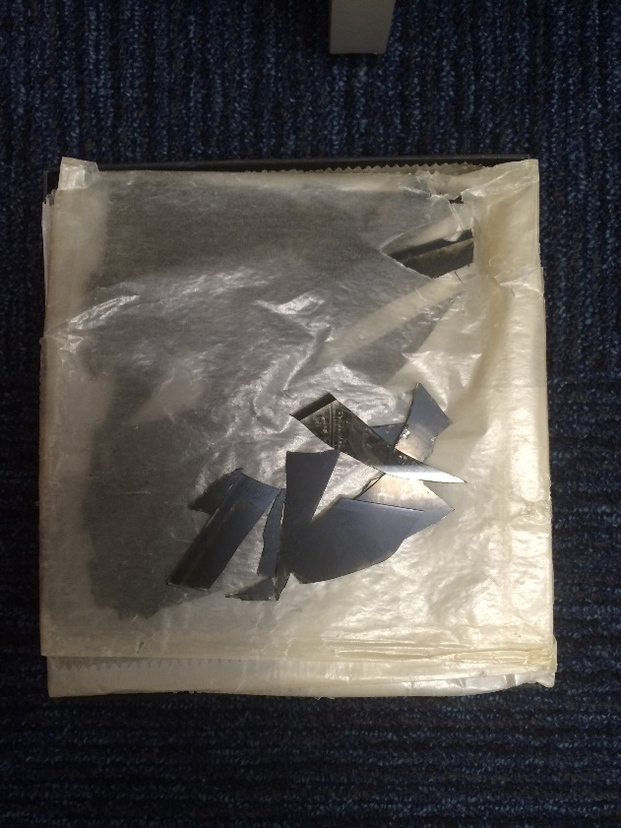
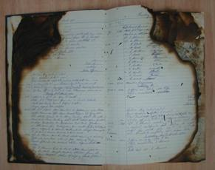
CONSERVATION
Agency visits and advice

Slide 8
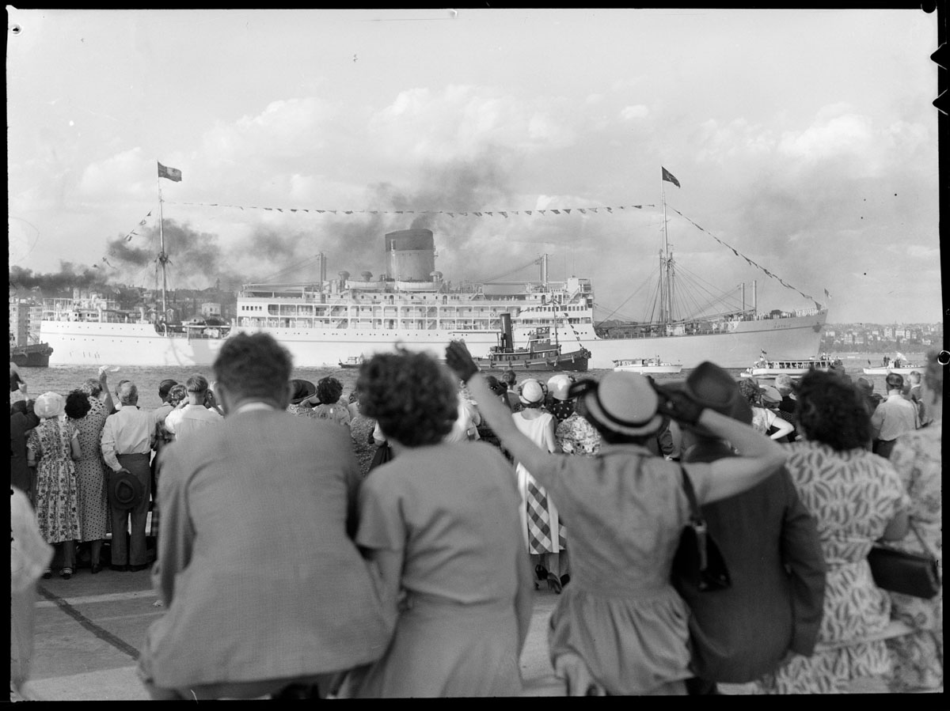
DIGITISATION
Digitisation Officer Anna Gray
Access
Enhance access to the collection
Reach an extended audience
Increase staff efficiency
Meet the publics expectations
Preservation
Preserve original though access of surrogate
Prevent loss of information
Conservation Record
Prevent format obsolescence

Slide 9
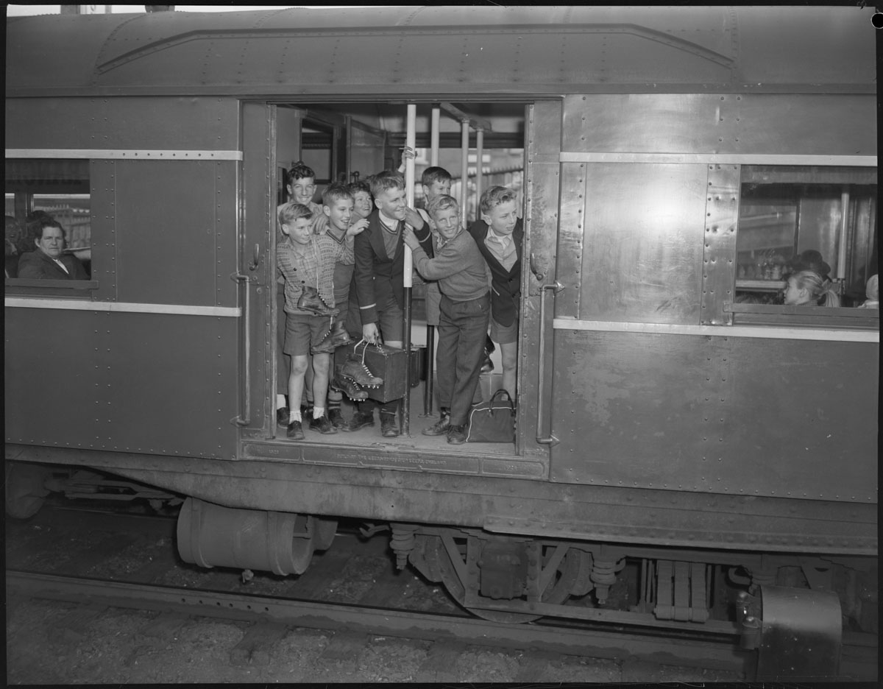
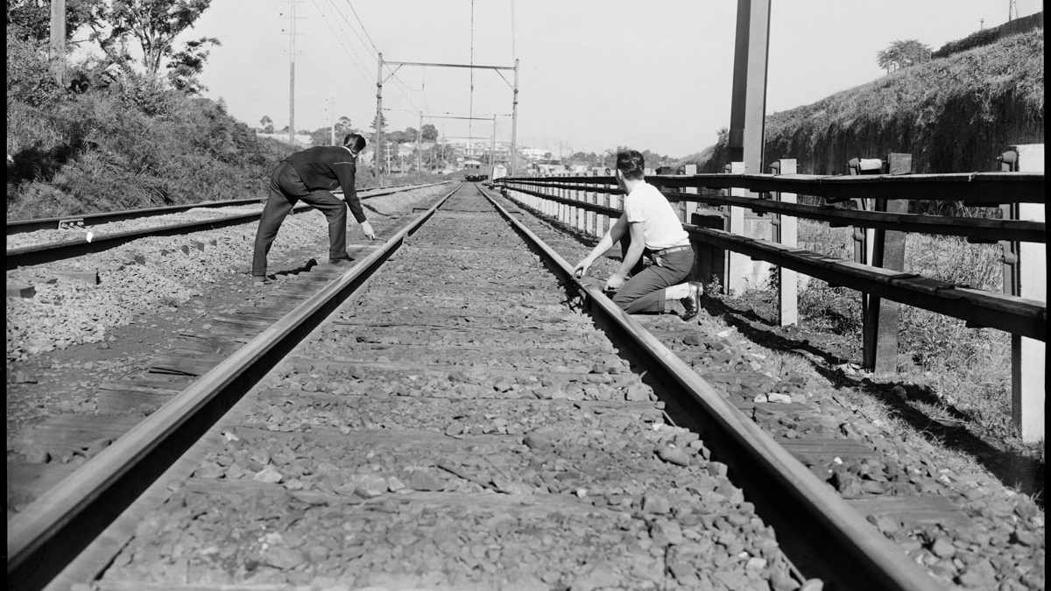
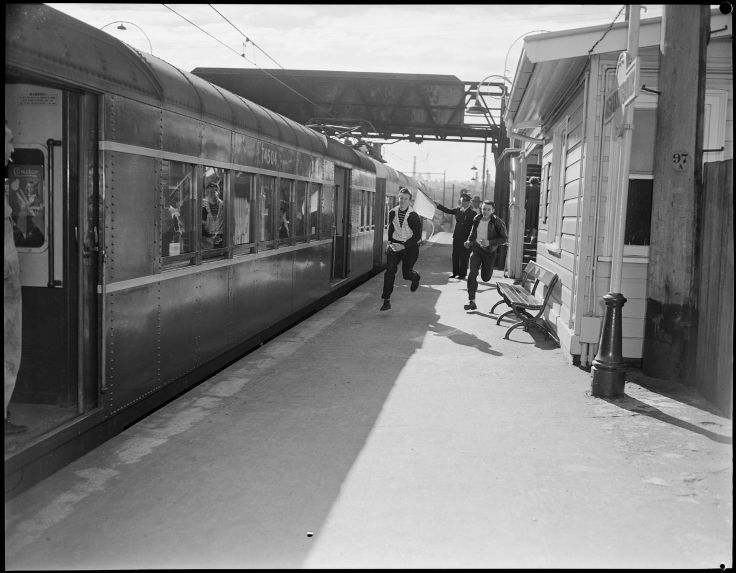
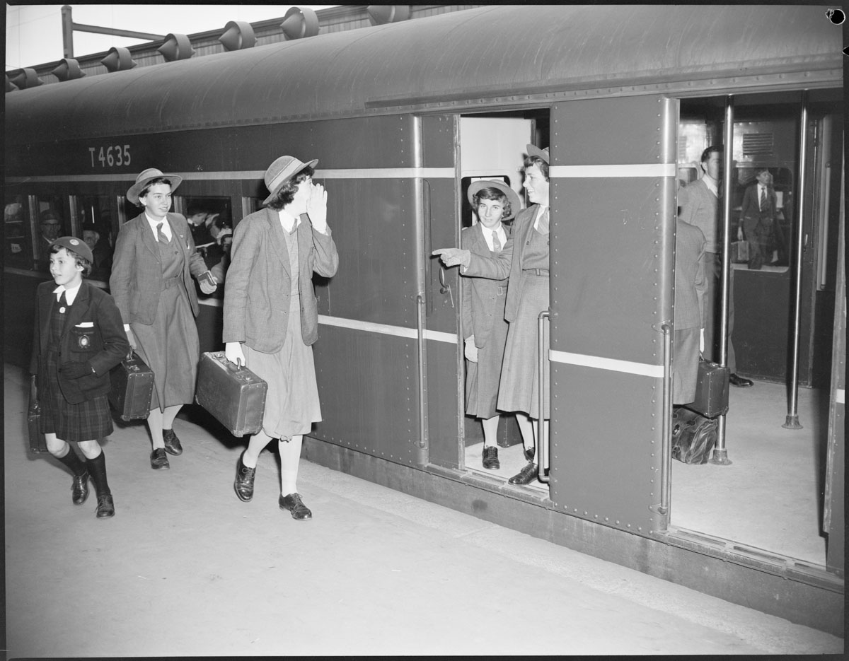
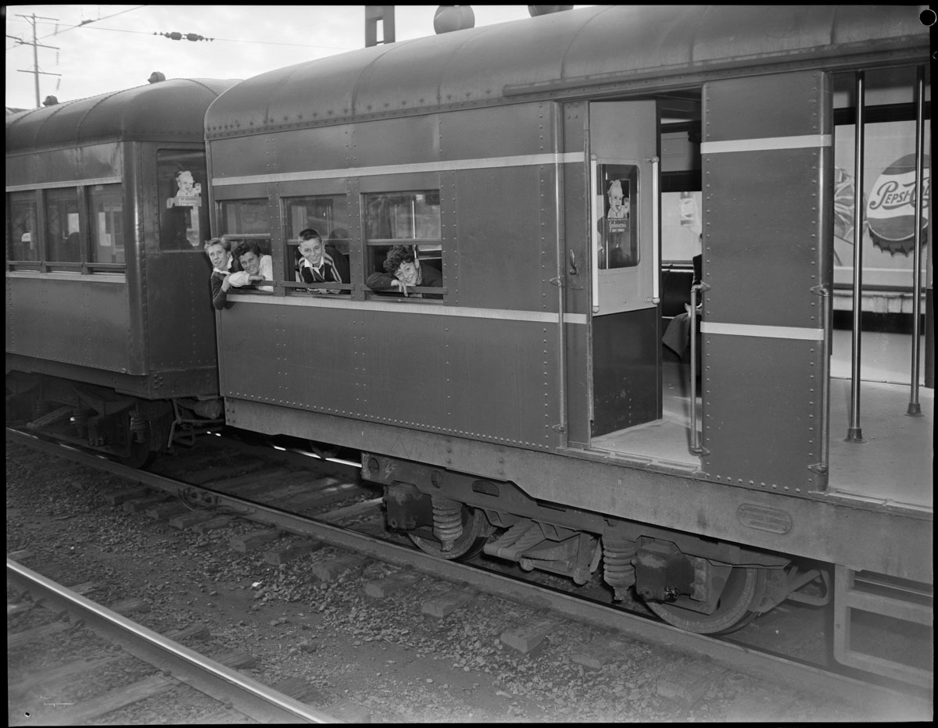
DIGITISATION
Digitisation Officer Anna Gray

Slide 10
COLLECTION SERVICES
Tel: (02) 9673 1788
Email: transfer@records.nsw.gov.au
Web: www.records.nsw.gov.au
Western Sydney Office: 161 O'Connell Street, Kingswood, NSW 2747
Sydney Office: The Mint, 10 Macquarie St, Sydney, NSW 2000
Post: PO Box 516, Kingswood, NSW 2747, AUSTRALIA

