Slide 1
Automating and improving business processes – University of Sydney Records Management Experience
April 2019
May Robertson
Records Manager

Slide 2
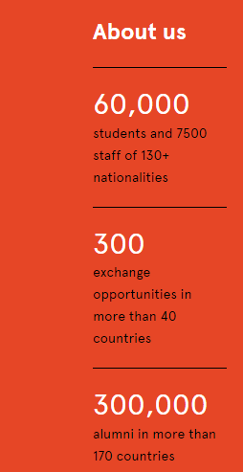
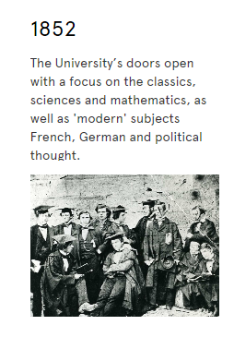
The University of Sydney
First University in Australia

Slide 3
Where does Archives and Records Management sit
Vice-Chancellor
The Office of General Counsel (OGC) is responsible for the provision of legal services to the University. The office also covers the areas of
Audit and Risk Management,
Archives and Records Management,
Trusts Office, and
Policy Management.
Office of General Counsel
Group Secretariat
Archives and Records Management Service

Slide 4
Records Management Services
Integration with business systems
  Student system
  Spec cons
  HR systems
  PeopleSoft finance
  Ezescan – provide digitisation solution
  Ariba
  ServiceNow (Track-it)
  IRMA (Upcoming)
Business system decommission and records migration
Recordkeeping consultancy service
Workflow
Registers
Contract register
Property register
Leasing register
Policy register
Student support system
Traditional Records Management Services
File creation
Paper file storage and retrieval
Repository management
File audit and maintenance
Records sentencing and disposal
Help Desk
Main contact for enquiries
Provide advice and technical support
Troubleshoot
Training
Request for personal information - subpoena and search warrants and 3rd party request for personal information

Slide 5
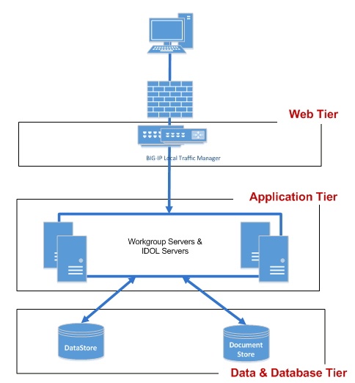
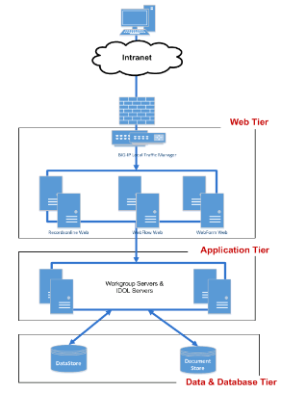
Recordkeeping system – Micro Focus Content Manager 9.1.2
Desktop Client
Web Client

Slide 6
Workflow
Wikipedia:
A workflow consists of an orchestrated and repeatable pattern of business activity enabled by the systematic organization of resources into processes that transform materials, provide services, or process information.[1] It can be depicted as a sequence of operations, the work of a person or group,[2] the work of an organization of staff, or one or more simple or complex mechanisms.
TRIM Workflow module is part of the TRIM application.
Initial investigation into the Workflow module in 2010 as part of a project on managing correspondence in the Vice-Chancellor’s Office
In PROD since 2012 - first process being Special Consideration Application and Approval process, closely followed by PhD students’ Annual Progress Review process

Slide 7
TRIM Workflow systems at the University
Currently automating the following business processes
  Education integrity case referral and handling
  Examination incidents reporting and handling
  Higher Degrees Research (HDR) student thesis examination issues handling
  HDR research impropriety issues handling
  Student complaint
  Students Appeals Body (SAB) - academic appeals handling
  Staff complaints, and eight other HR related case handling systems
  Vice-Chancellor Office – for signature log
  Sexual assault and sexual harassment reporting Portal
  Declaration of External Interest, outside earning and gifts Portal
  Patient consent form lodgement for Medicine students
  Discontinue not Fail application
  Autonomous Sanction compliance
  Going live soon
  Trusts account enquiry and creation forms
  Referral services to CAPs
  Medicine Executive Deans approval portal
  Faculty decision – student academic appeals

Slide 8
Common requirements or characteristics
Complex processes across different faculties and/or portfolio
Seek consistency on handling and decision-making - seen as an instrument for the application of University policies and procedures
See case through to completion – not leaving it half-done
Adhere to timeline or reduce the turnaround time required
Eliminate paper records
There is a need to know “prior case history”
User friendly for academic staff members
Good recordkeeping done by the system
Secure and authorised access to case records
Become more efficient – by automating tasks and removing unnecessary manual steps
Right process, every time - sequential workflows put the right information in front of the right people at the right time
Focus on real core work, not admin - time savings allow managers to focus on decision-making and strategic work

Slide 9
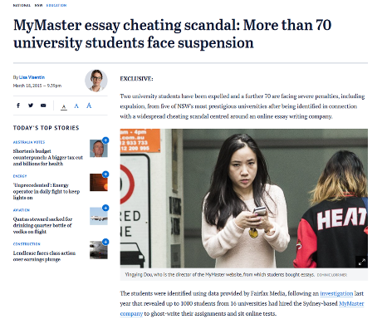
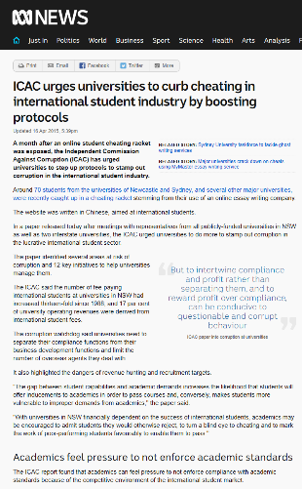
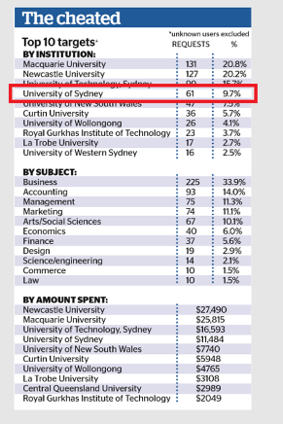
The business problem

Slide 10
Vice-Chancellors Taskforce Report
Identified:
Under reporting
Found 10 of the 16 faculties had some level of non-compliance with the “Academic Dishonesty and Plagiarism in Coursework” Policy
7 of the 16 faculties found with some level of recordkeeping
Only 3 of the 16 faculties used TRIM to keep such records
“….Staff feedback from the Faculty of Arts and Social Sciences’ TRIM workflow is easy to use and significantly reduces workload…”
Resource implications for nominated academic and faculty administrative staff
Recommended:
One of the five recommendations the Taskforce put forward was to provide an accessible, searchable and complete recordkeeping facility across the University, and
The Taskforce also recommended the TRIM Workflow designed for Faculty of Arts and Social Sciences be further developed and implemented across all faculties.

Slide 11
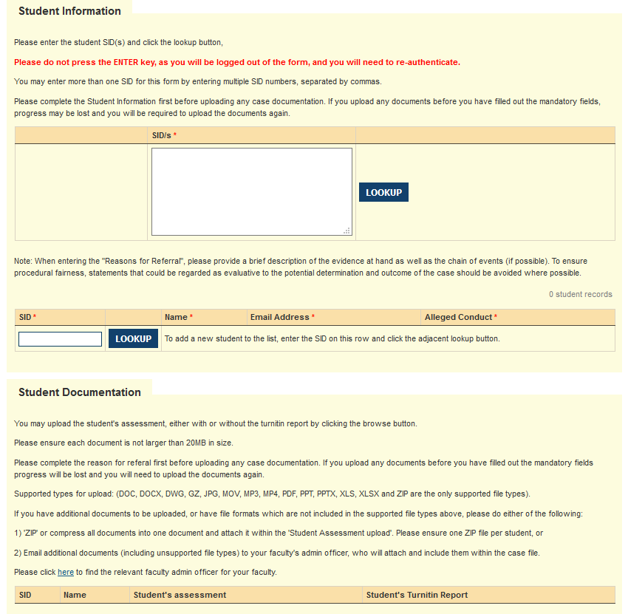
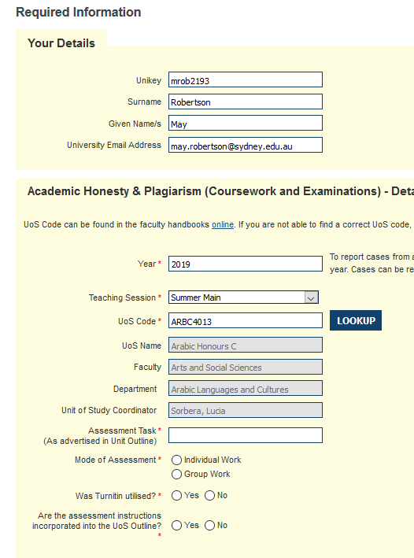
System design – TRIM Web Form
Copy and paste up to 20 Student IDs
Unikey Authentication
Default to current year
Enter 8 digit UOS code

Slide 12





The Process
Suspected case
Academic Staff
Lodge case Online
Academic Integrity
Officer Verify
Nominated Academic
no impropriety or further education
Nominated Academic
Case determination
email notification/decision
to student
Student resubmission
Academic Integrity Officer
Closes case/refers to Registrar
Academic Integrity
Officer prepares communication
Resubmission marked/penalty applied/result communicated to Academic Integrity Officer
email notification/decision
to staff

Slide 13
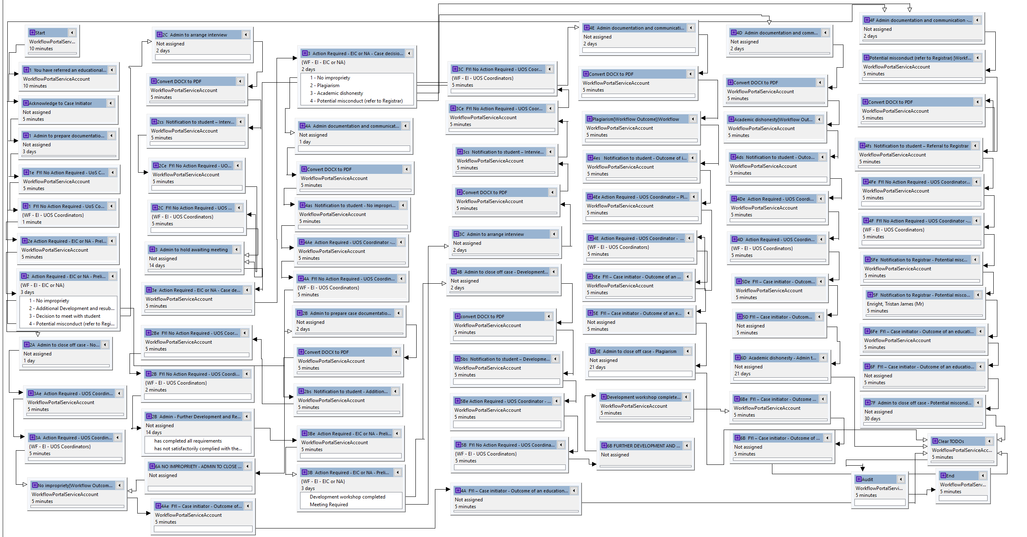
WORKFLOW TEMPLATE IN TRIM

Slide 14
Case Handling - Roles and Interfaces
Stakeholder | Engagement with system
Case initiators | Receive email notifications at case lodgement and resolution
UOS Coordinators | Receive email notifications regarding case lodgement, progress and determination, and implements case outcomes as specified by EIC/NA
Students | Receive email notifications regarding allegations and decisions
Faculty administrators | Administer individual cases and the faculty-level process via the workflow portal, including provision of policy and procedural advice to academic staff/decision makers
Educational Integrity Co-ordinators (EIC) or nominated academics (NA) | Review and determine cases via e-mail (recommended) or the workflow portal
Registrar (via Student Affairs Unit) | Receives potential misconduct referrals via email notifications

Slide 15
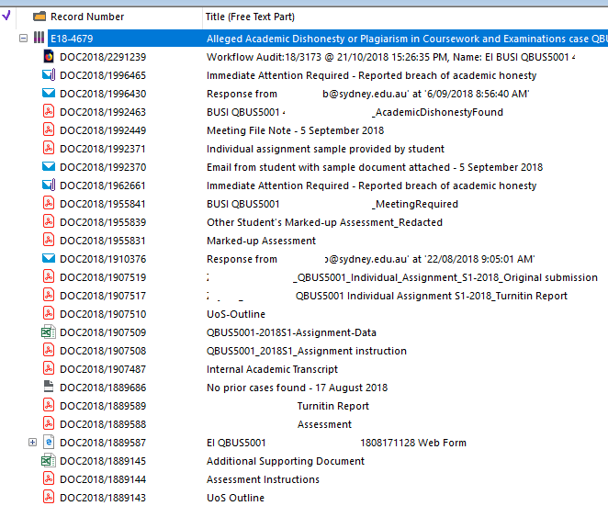
Case documents – structure
Case folder
Workflow audit file
Communications along the process
Records around decision making and evidential documents
Decision letters
Other attachments submitted at lodgement
Prior history report
Web form output (initiating document)

Slide 16
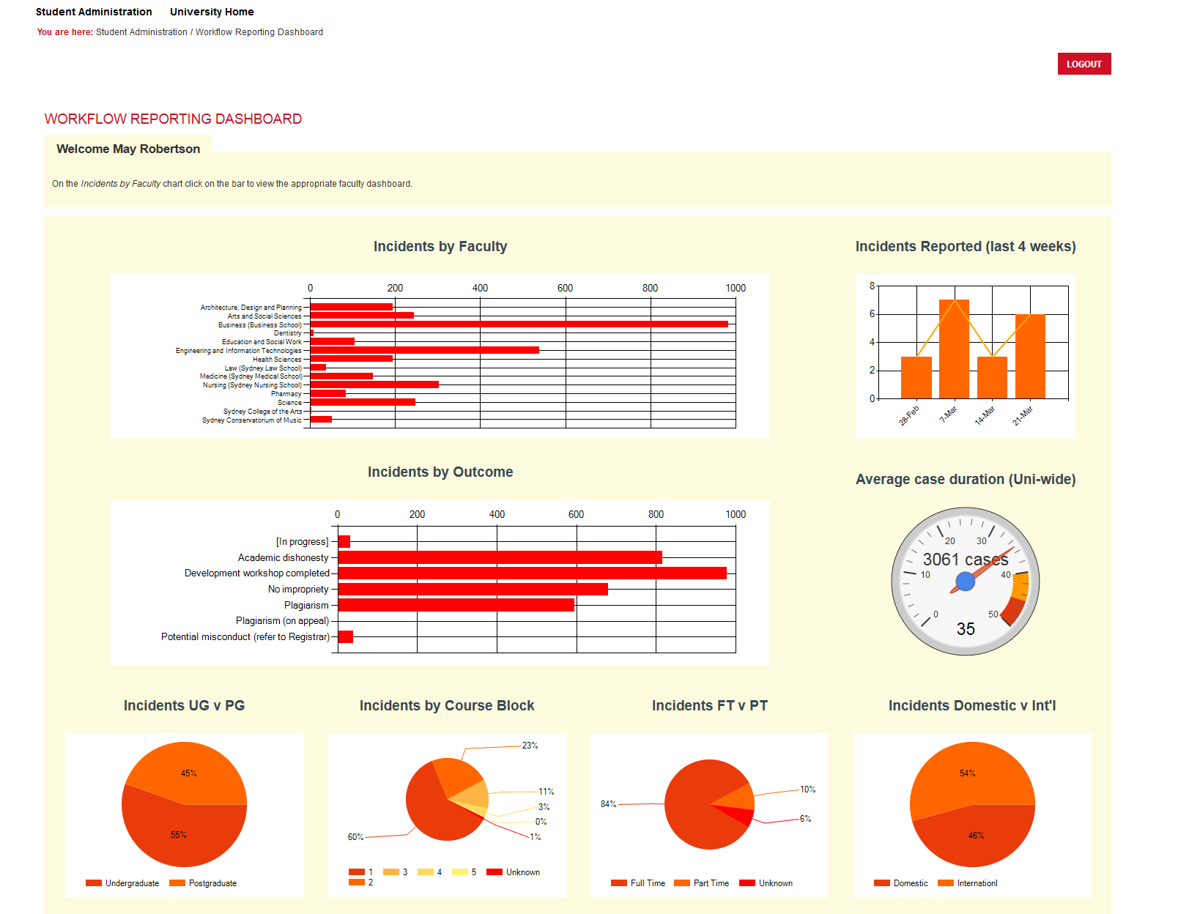
TRIM Dashboard – example using Educational Integrity Workflow

Slide 17
Case study – allegation or complaint handling systems
TRIM Web Form
Allow anyone with a valid Unikey to lodge a form
Comsume current staff student information from University enterprise systems
Unikey authentication
Form capture and
Kick off process
TRIM Workflow
Architecturally designed to serve Policy and Procedure
Auto-routing of tasks
Consistency and Transparency
Provide guidance at each step of the way
TRIM Dashboard
Harvests case outcomes, individual profiles and other case data for reporting and business analytic purposes
Applying or
Reporting
Processing and Handling
Detailed
Reporting
CONSISTENT, COMPLETE and EVIDENCE BASED DECISIONS
GOOD RECORDKEEPING
Capture case documents from the point of lodging a complaint and along the way
Strategically harvest case data
Provide audit trail record
Secure and authorised access to documents
Efficiency gain - document template, document assembly, PDF converting

Slide 18

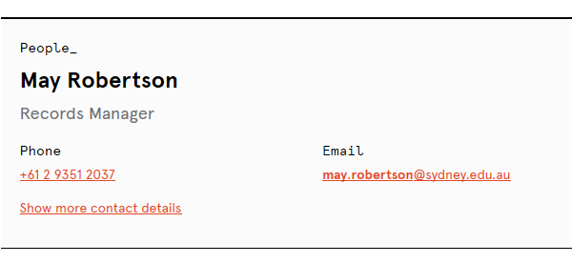
Contact and Questions

