Slide 1
State Archives Management System (SAMS) Project
Fiona Sullivan
A/Manager Engagement and Access Services

Slide 2
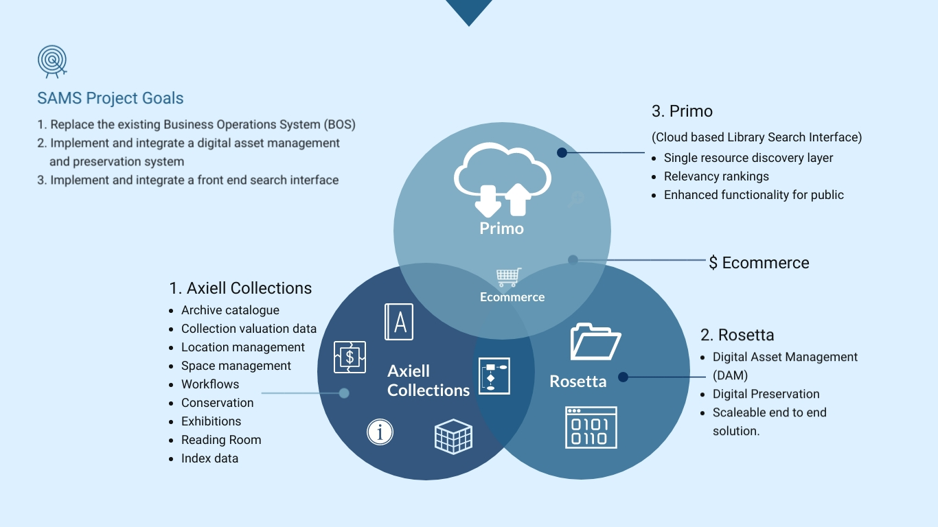
State Archives Management System

Slide 3
Collection Search – What’s new with SAMS?
6,500 additional series
A single discovery layer of catalogue and index data (over 4 million records)
Save searches, favourites and tag records
Filters for easy navigation
Prefixes used to distinguish entity types
  NRS = Registered Series and Items
  RNCG = Unprocessed Series
  AGY = Agency
Wildcard searches
  ? = single character
  * = multiple character

Slide 4

Questions?

